Slide 1
Unit 2: Convolutional Neural Networks (CNN)

Slide 2
Contents
Components of CNN
Fundamentals of image representation
Introduction to Convolutional Neural Networks
Layers in CNN
Types of convolutions.
Standard CNN models: AlexNet, VGGNet, GoogLeNet, ResNet, Inception (Hands-on).
Implementation of CNN using Keras
Basic model
Transfer Learning

Slide 3
Session 1
Components of CNN
Fundamentals of image representation
Number of channels
Why not use Fully Connected NN for Images?
Preprocessing and how to store the data

Slide 4
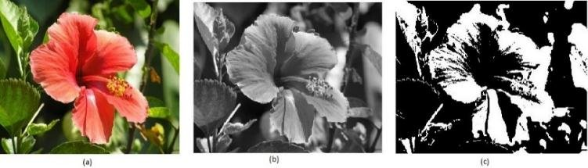
Image types
(a) RGB image
(b) Grayscale image
(c) Binary image
Image source:
Figure - uploaded by Sanskruti Patel

Slide 5
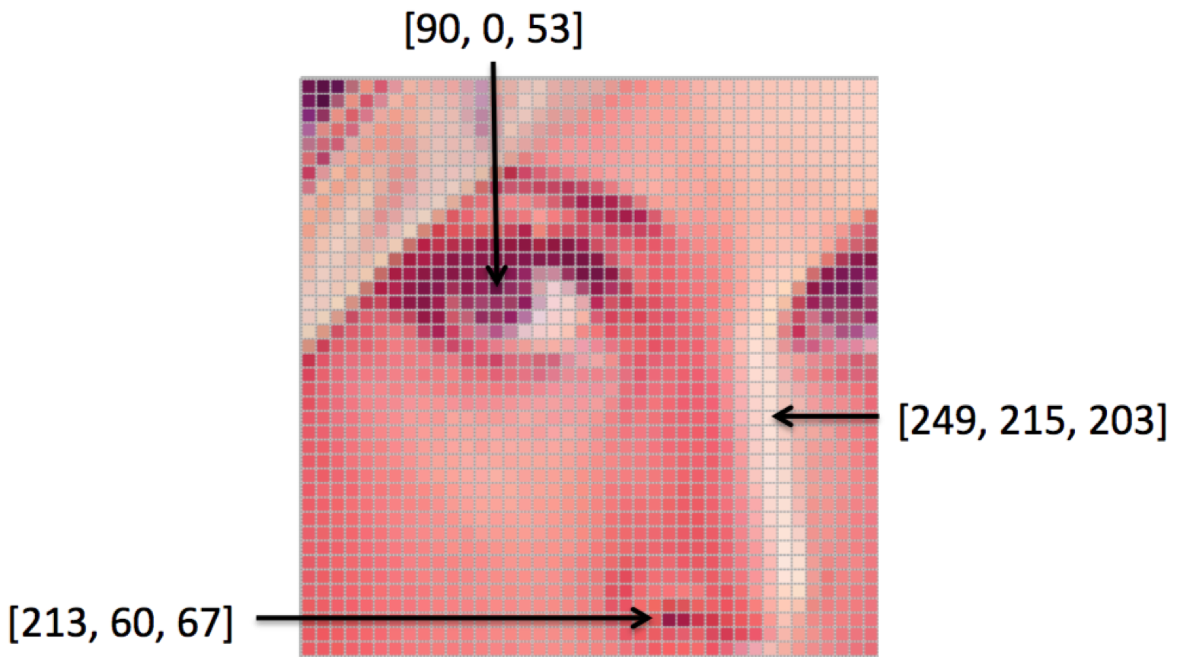
Image representation
An image is a grid of pixel values, which are just numbers.
https://ai.stanford.edu/

Slide 6
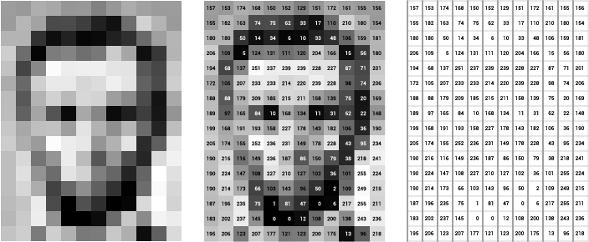
Image representation
An image is a grid of pixel values, which are just numbers.
https://ai.stanford.edu/

Slide 7
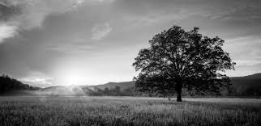
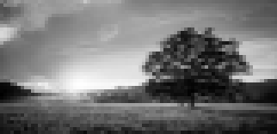
Number of channels
Only shades of gray — from black to white
Each pixel needs 1 number to show how light or dark it is
Example: 0 = black, 255 = white, 128 = medium gray
So, only 1 channel is needed
https://giventofly.github.io/pixelit/

Slide 8
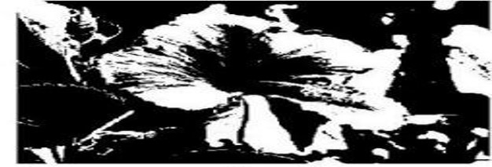
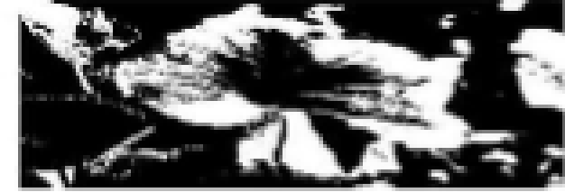
Number of channels
https://giventofly.github.io/pixelit/
Binary means only 2 colors:
black or white.
Each pixel is either 0 or 255 or
0 (black) or 1 (white)
Again, just 1 number per pixel is still 1 channel.

Slide 9


Number of channels
Red, Green, Blue to create any color.
Each pixel needs 3 numbers:
One for Red, One for Green, One for Blue
Example: (255, 0, 0) = pure red
3 channels
https://giventofly.github.io/pixelit/

Slide 10
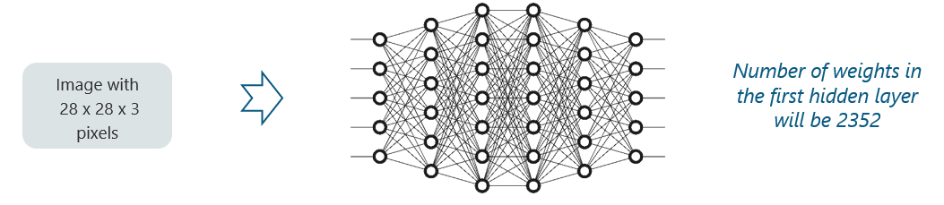
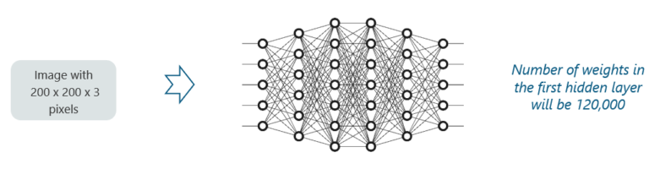
Why not fully connected networks? (ANN)
Full HD (1920 x 1080 × 1)
QHD (2560 x 1440 × 3)
4K UHD (3840 x 2160 × 1)

Slide 11
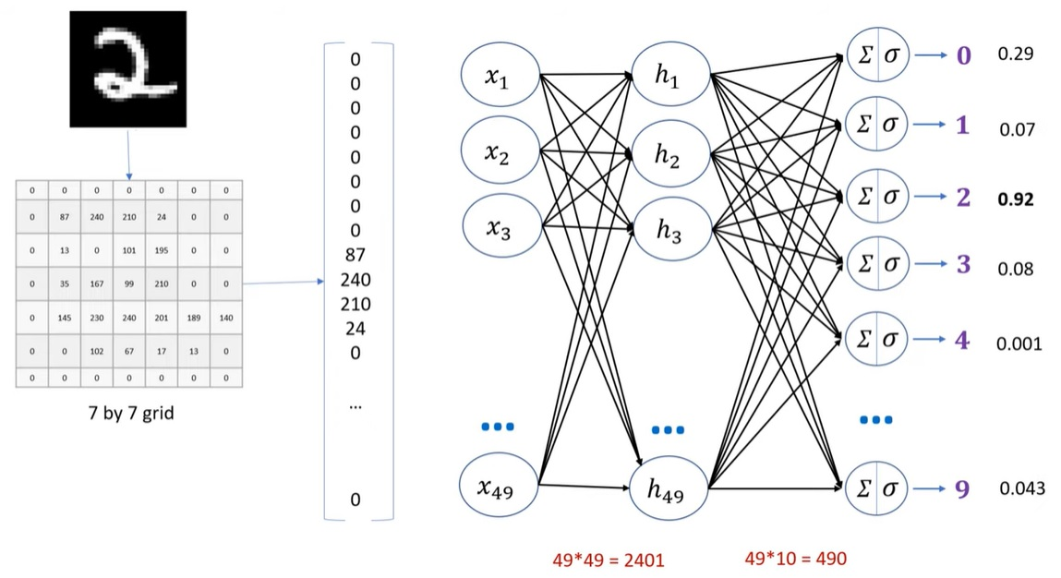
Example
Loss of Spatial Structure:
Flattening images into 1D input vectors destroys spatial relationships between pixels.
FCNNs don’t leverage local patterns like edges, textures, or shapes.
[1, 2, 3, 4, 5, 6, 7, 8, 9]
[[ 1, 2, 3 ],
[ 4, 5, 6 ],
[ 7, 8, 9 ]]
Horizontal neighbors: 1–2–3, 4–5–6, 7–8–9
Vertical neighbors: 1–4–7, 2–5–8, 3–6–9
Training slow and increases overfitting risk
Parameter Explosion

Slide 12
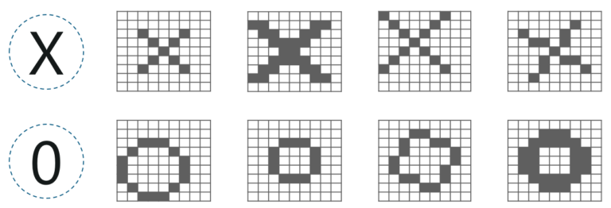
Preprocessing
Scaling
Weight
Translation
Rotation
Translation
Scaling
Rotation
Weight

Slide 13
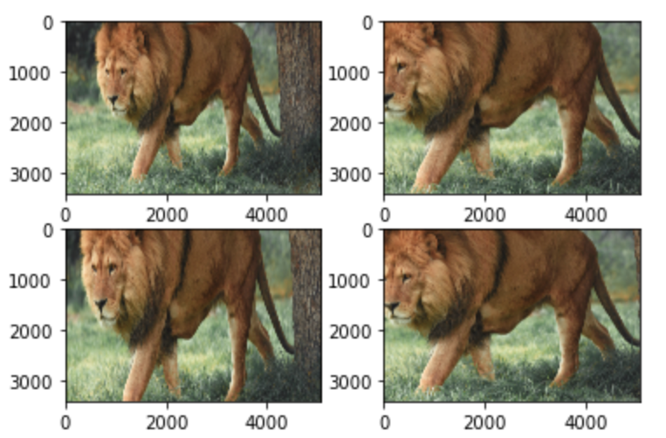
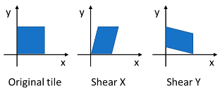
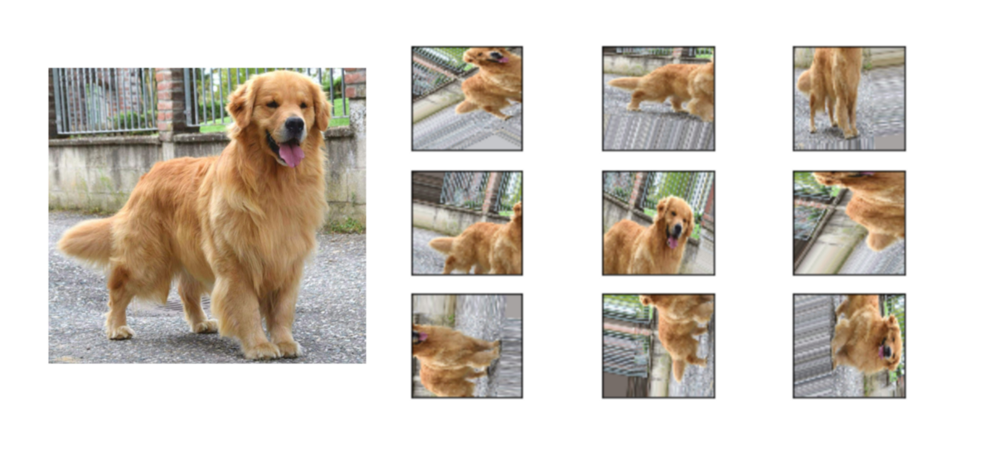
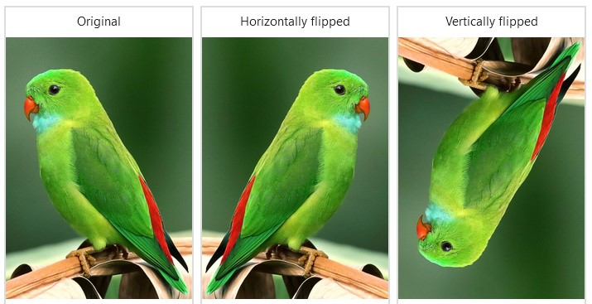
Preprocessing
Helps the model learn to recognize objects at different scales.
Slants the shape of an image along one axis.
from tensorflow.keras.preprocessing.image import ImageDataGenerator
train_datagen = ImageDataGenerator(rescale = 1./255, shear_range = 0.2, zoom_range = 0.4, vertical_flip=True, horizontal_flip = True)
test_datagen = ImageDataGenerator(rescale = 1./255)

Slide 14
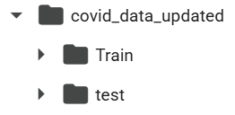
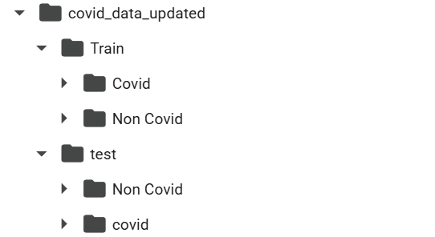


How to store the data
This is an instance of ImageDataGenerator, It handles image preprocessing and augmentation.
Expect the folder at 'path'. Each subfolder is treated as a class label, and all images in that folder are labeled accordingly.
Keras automatically labels the images based on the subfolder names:
Example:
All images in Covid/ get label 0
All in Non Covid/ get label 1 (or vice versa, depending on alphabetical order)
training_set = train_datagen.flow_from_directory(
'path/to/your/data',
target_size=(height, width),
batch_size= 8 or 16 or 32,
class_mode='binary' or 'categorical'
)
Loads 8 /16 /32 images at a time into memory during training
This function resizes all input images to height and width (e.g., 64×64 or 32×32 or 512×512 pixels), regardless of their original size.
This is required because CNNs need a consistent input shape.

Slide 15
Session 2
Introduction to Convolutional Neural Networks
Layers in CNN
Types of convolutions

Slide 16
Introduction to CNN
A convolutional neural network (CNN or ConvNet) is a type of deep learning neural network, and it has been applied successfully in various computer vision tasks, such as image classification, object detection, and image segmentation.
Spatial Feature Learning:
CNNs automatically detect patterns like edges, textures, and objects.
Filters learn localized features that are position-invariant and scale well.

Slide 17
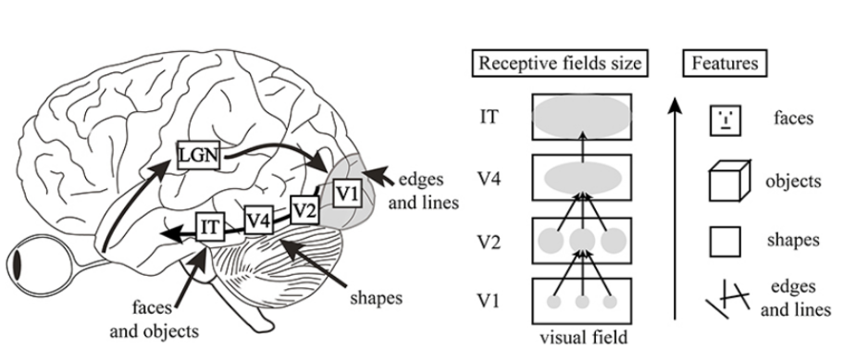
Inspiration Behind CNN and Parallels With The Human Visual System
IT (Infero-temporal Cortex):
High-level visual area responsible for recognizing faces, objects, and complex patterns.
Final stages of object recognition.
V2, V4 (Secondary and Tertiary Visual Areas):
V2 integrates basic features into shapes.
V4 is involved in detecting color and more complex object parts.
Human Visual Cortex Ventral Pathway
V1 (Primary Visual Cortex):
Detects basic visual features like edges and lines.
These are the lowest-level features in the visual hierarchy.

Slide 18
Brain Area | Function | CNN Equivalent
V1 | Detects edges and lines | Early convolutional layers
V2 | Detects basic shapes | Middle conv layers
V4 | Detects object parts, intermediate complexity | Deeper conv layers
IT | Recognizes complete objects and faces (abstract concept recognition) | Fully Connected Layers (after flattening)

Slide 19
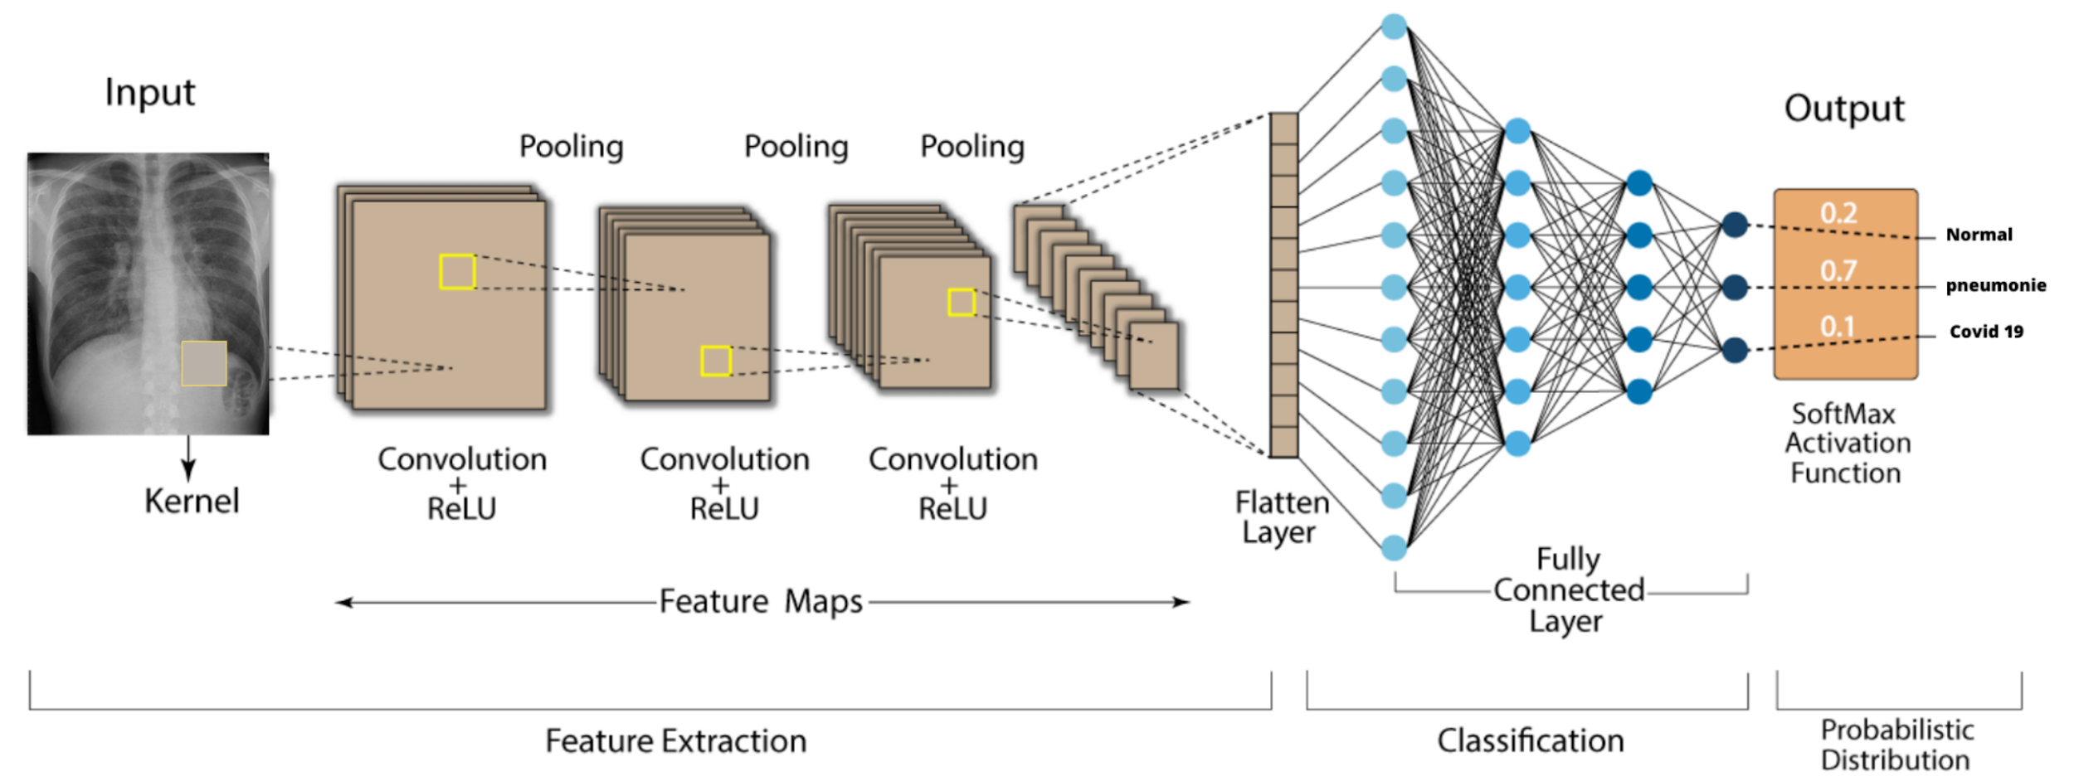
Key Components of a CNN
(5) Fully Connected Layer
(1) Input
(2) Convolutional Layer
(5) Output Layer
(3) Activation Function
(4) Pooling Layer
https://doi.org/10.3390/electronics11111775

Slide 20
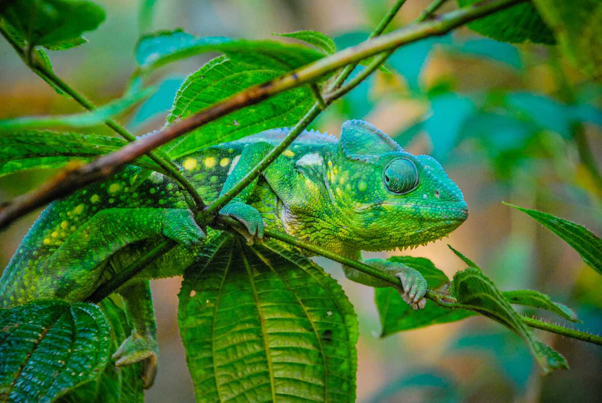
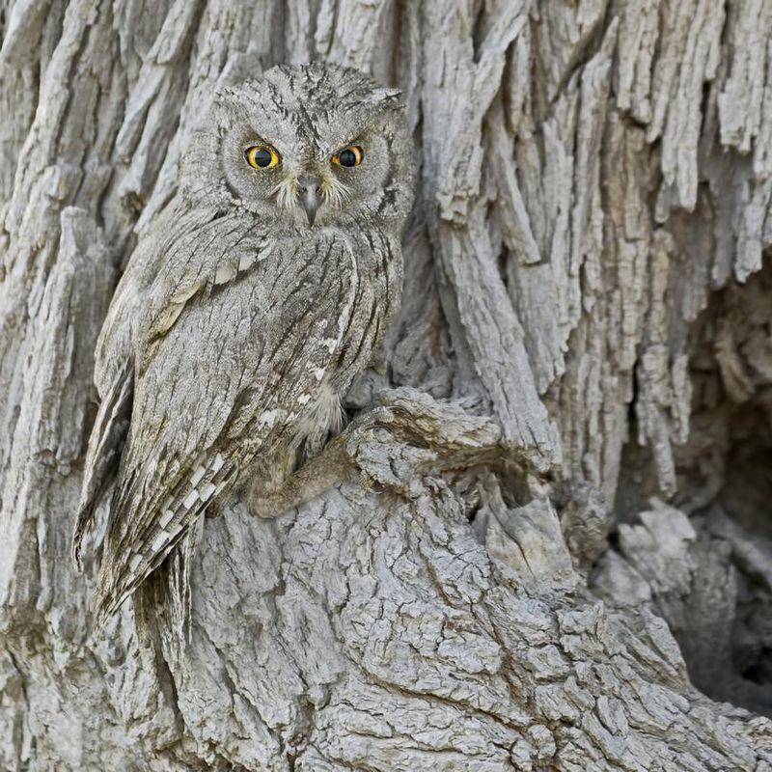
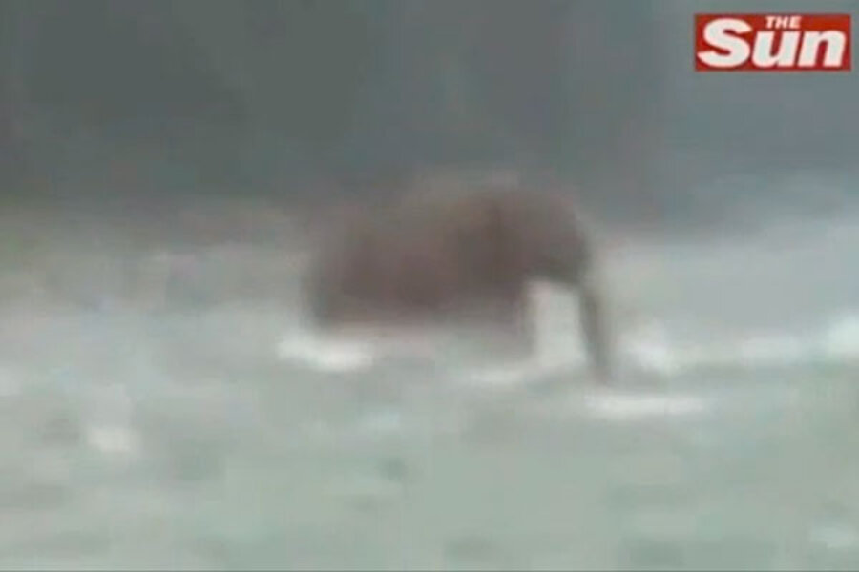
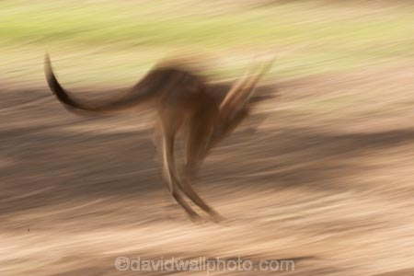

Slide 21
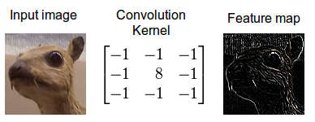
Convolution Layer
Convolutional layers scan the input data using filters (kernels) to detect patterns like edges, textures, or shapes.

Slide 22
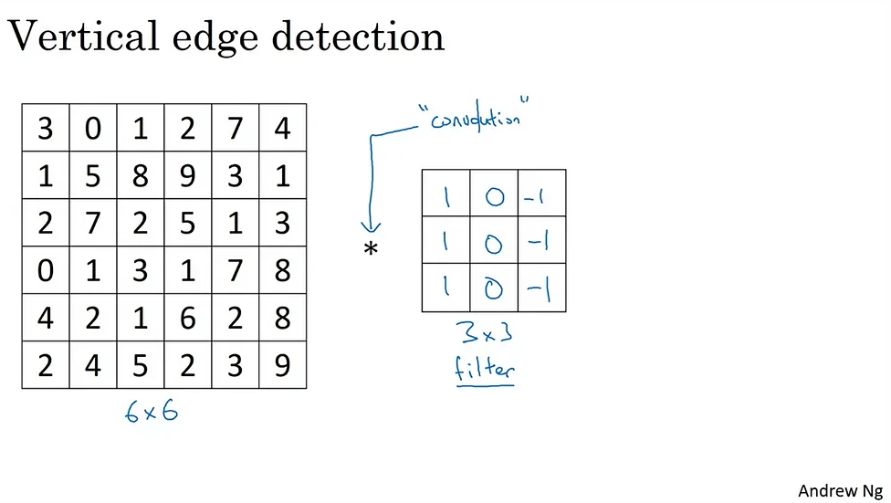
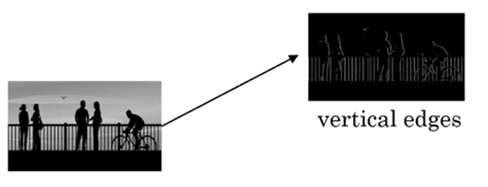
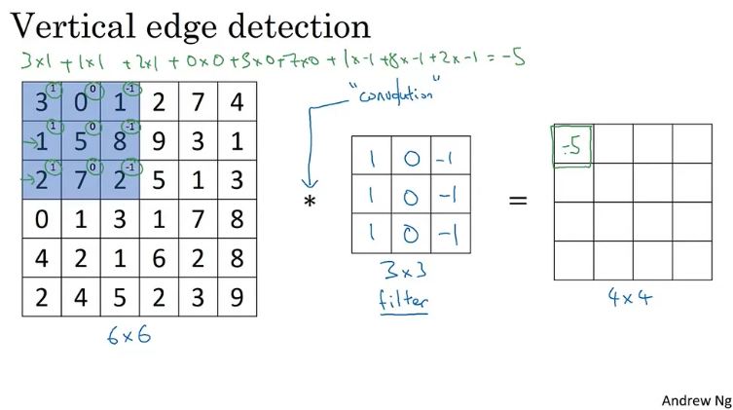
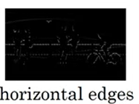
CNN: Edge detection
At each location, the filter performs an element-wise multiplication (dot product) and sums the result.

Slide 23
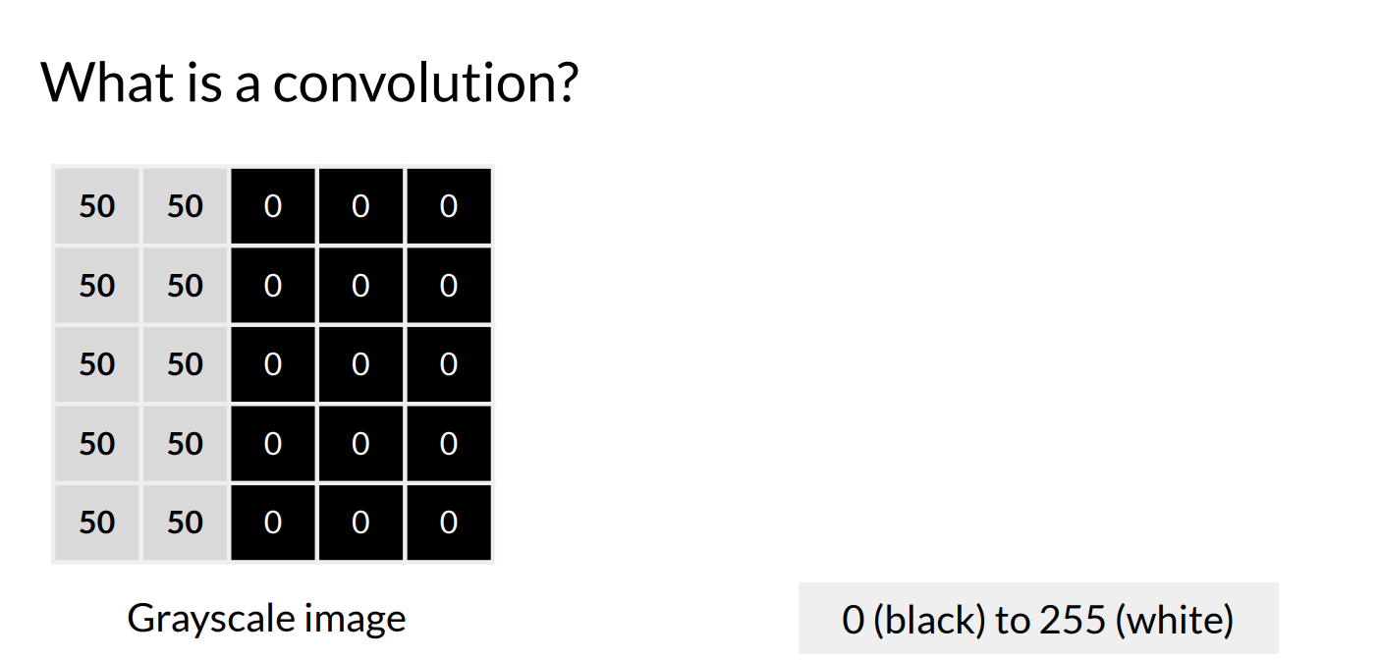

Slide 24
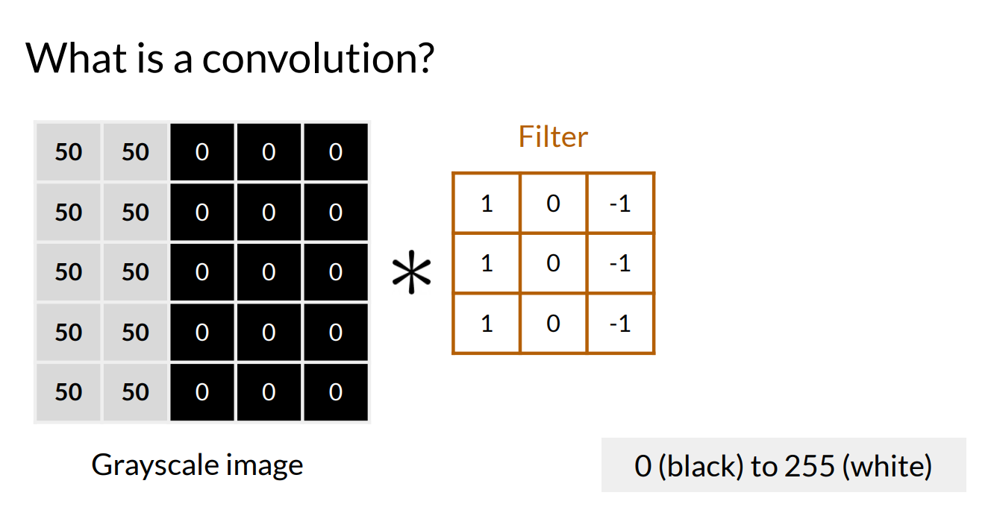

Slide 25
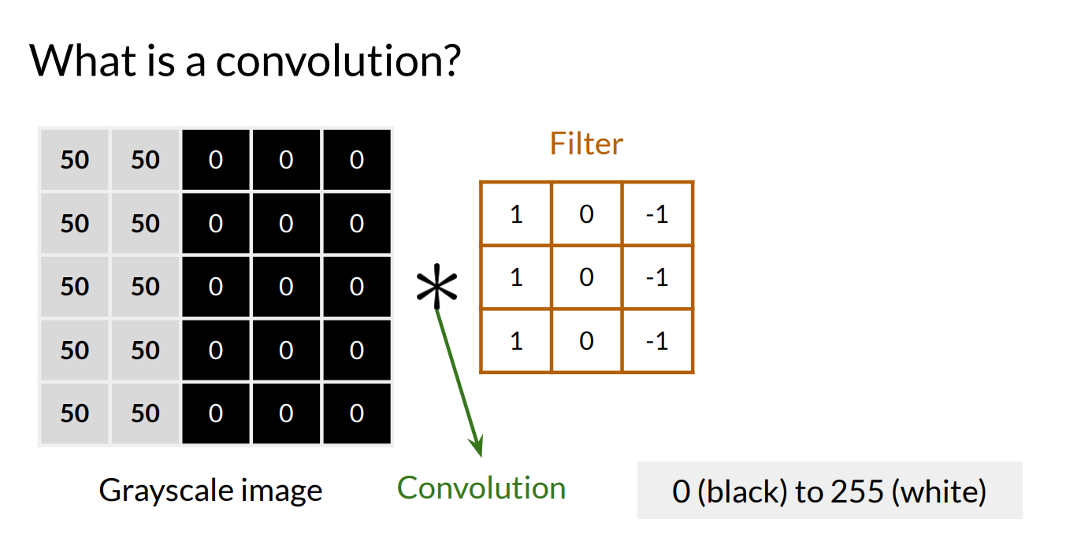
Convolutions is a fundamental operation where a "filter" (or kernel) slides across the input data, performing a matrix multiplication and summing the results to create a feature map, highlighting specific patterns or features

Slide 26
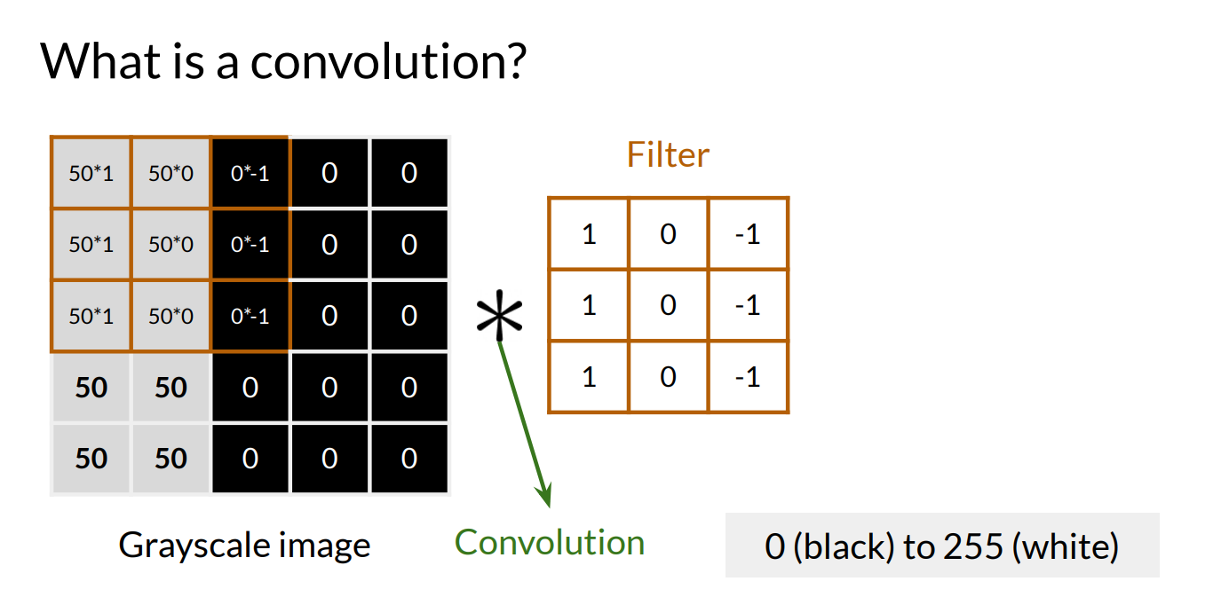

Slide 27
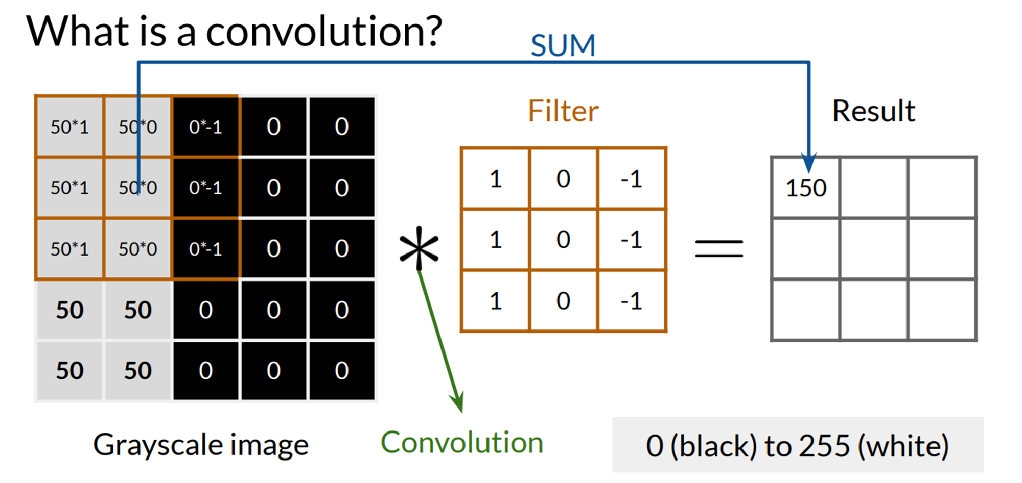

Slide 28
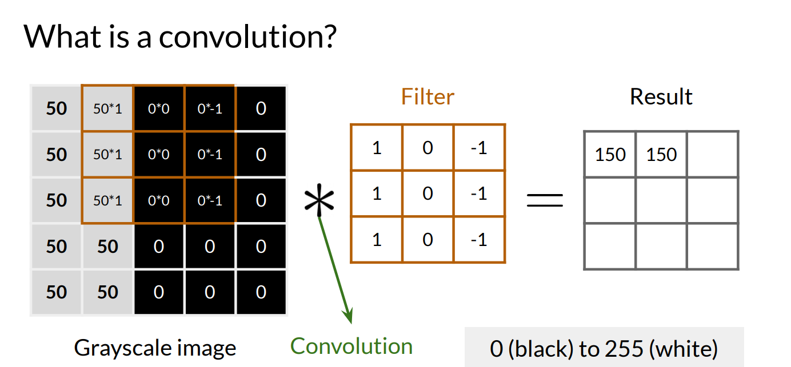

Slide 29
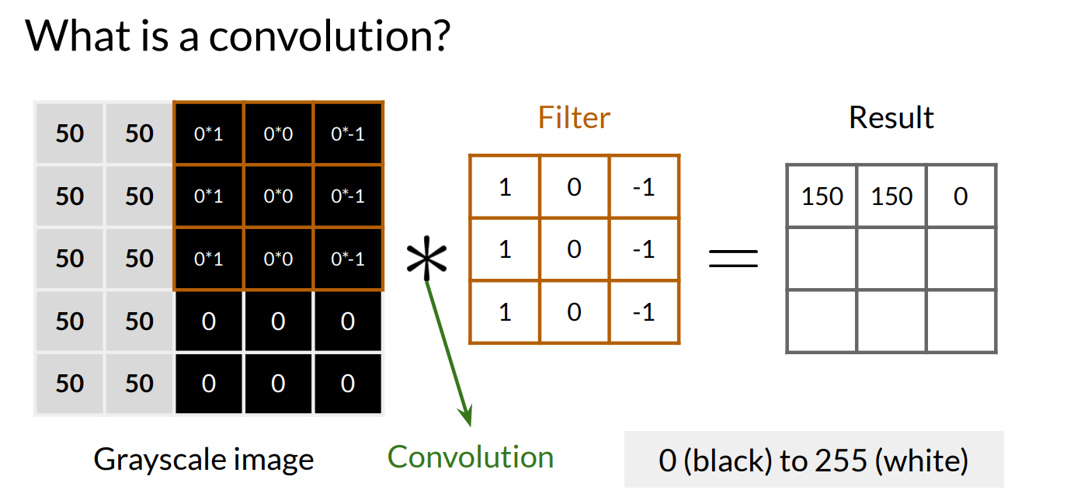

Slide 30
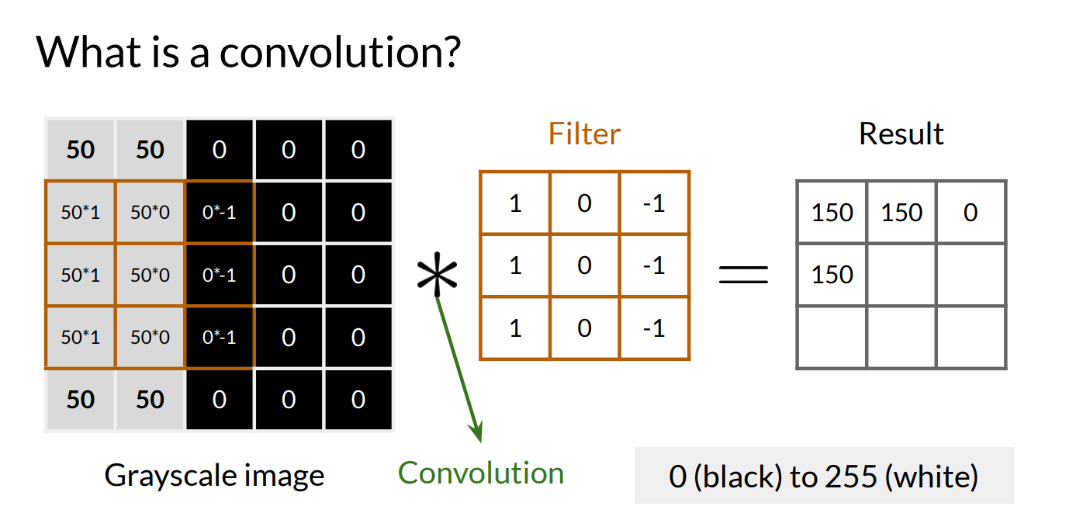

Slide 31
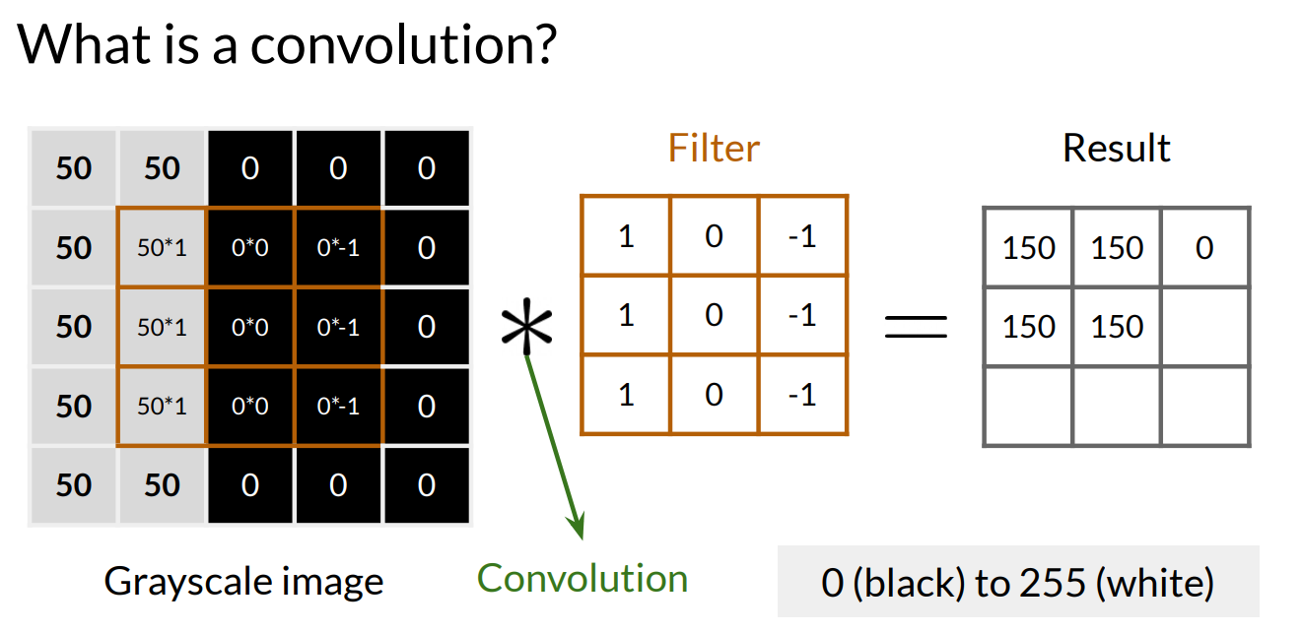

Slide 32
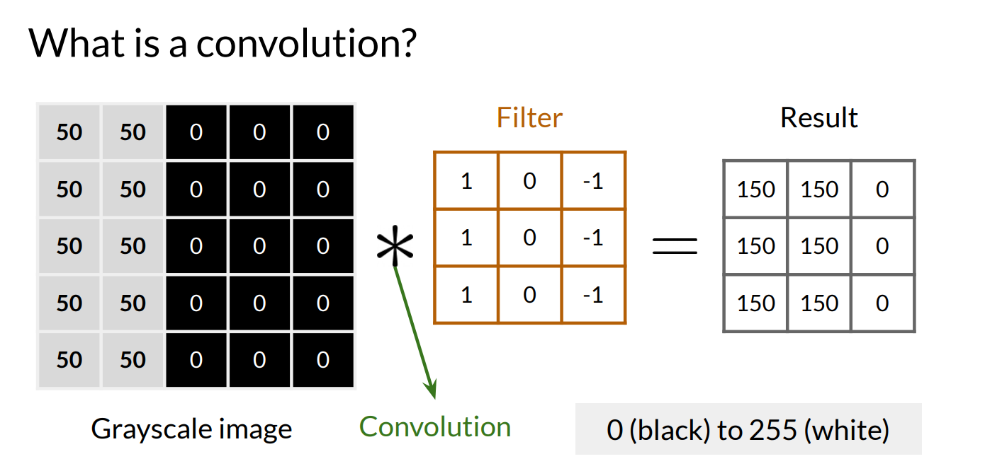

Slide 33
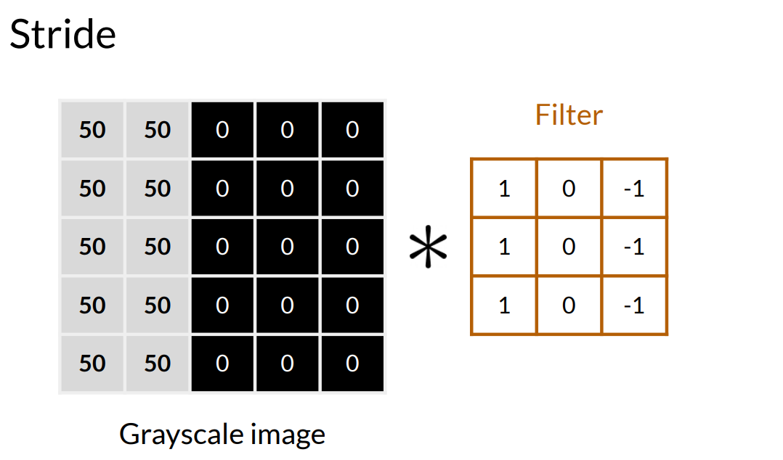
Stride in Convolutional Neural Networks (CNNs) defines how much the filter moves across the input image at each step. It directly affects feature extraction, output size, and computational efficiency.

Slide 34
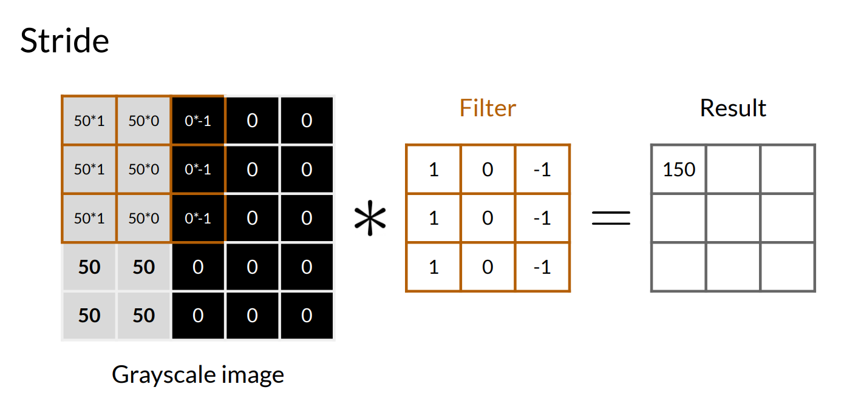

Slide 35
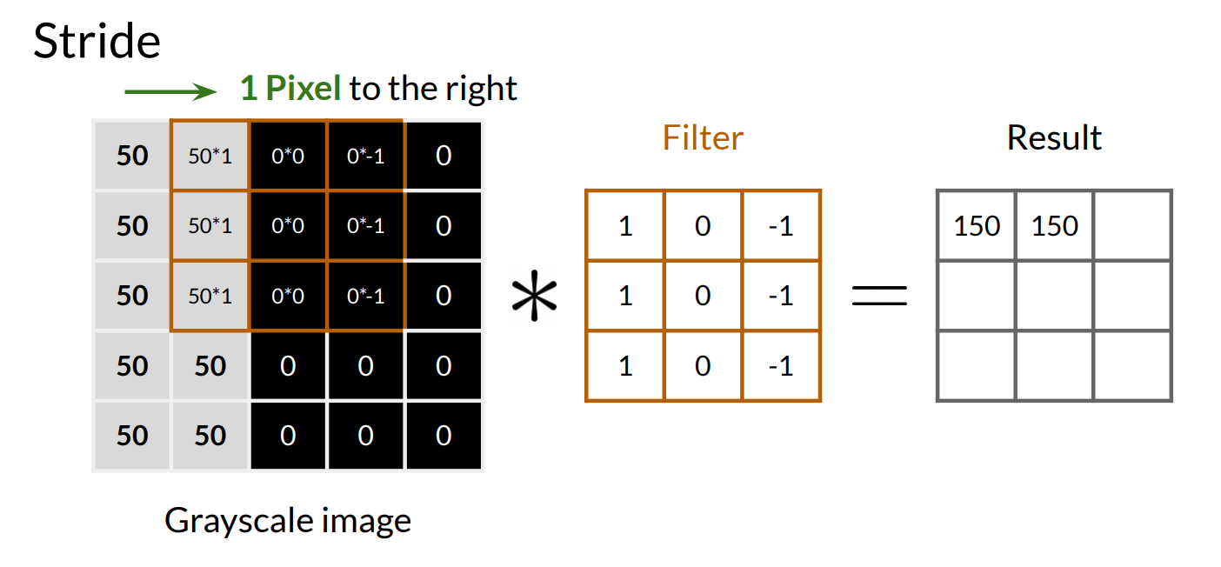

Slide 36
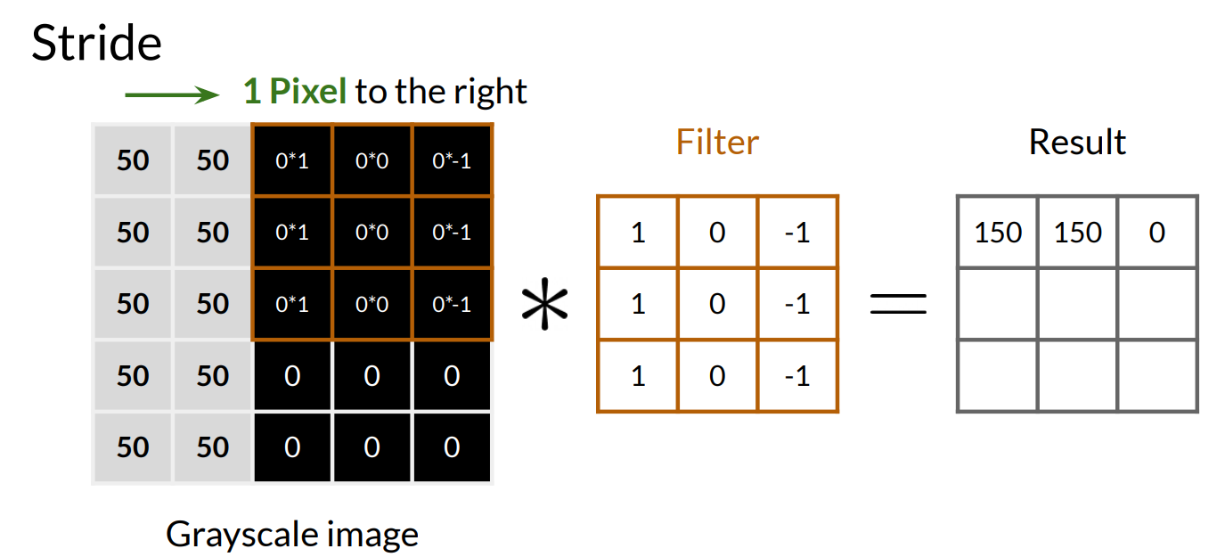

Slide 37
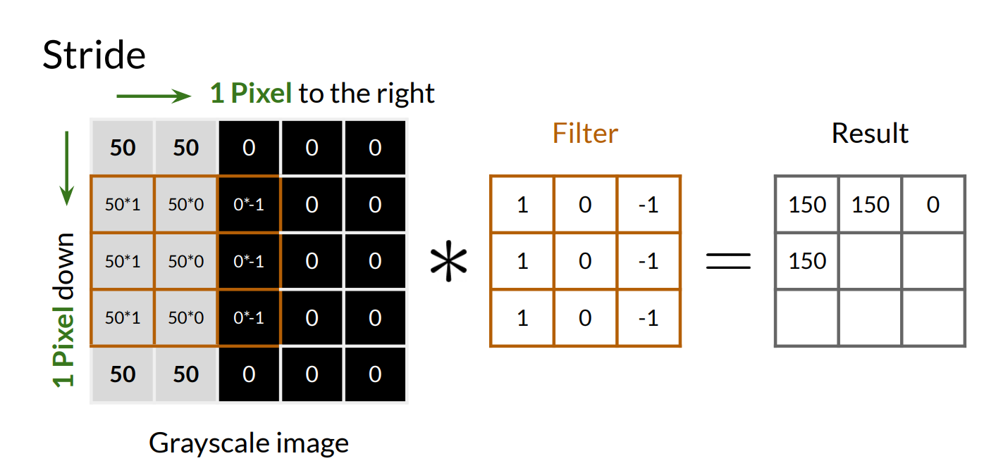

Slide 38
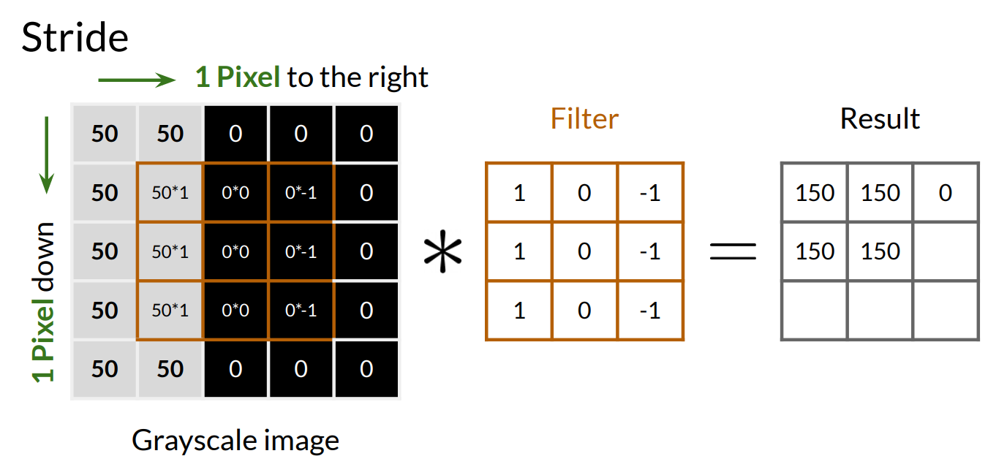

Slide 39
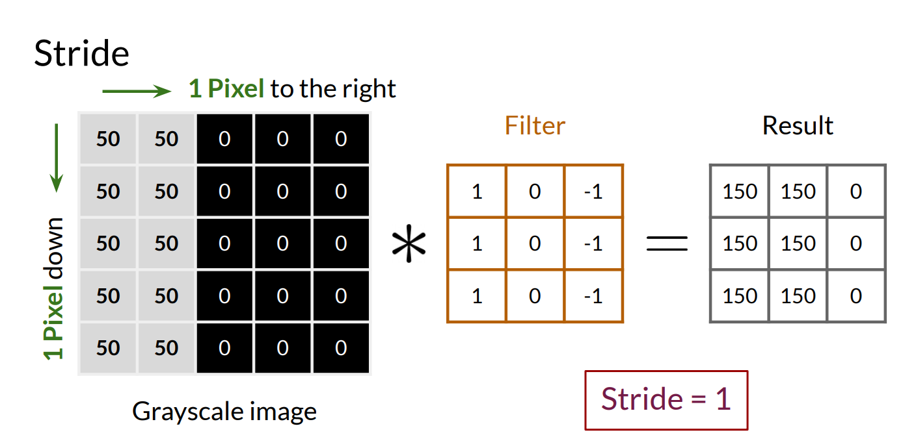

Slide 40
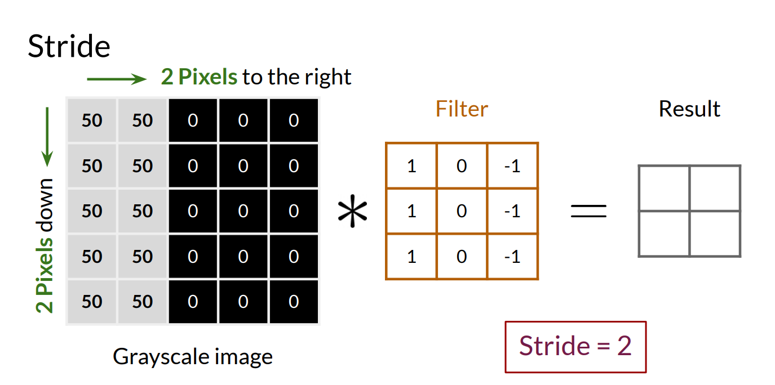

Slide 41
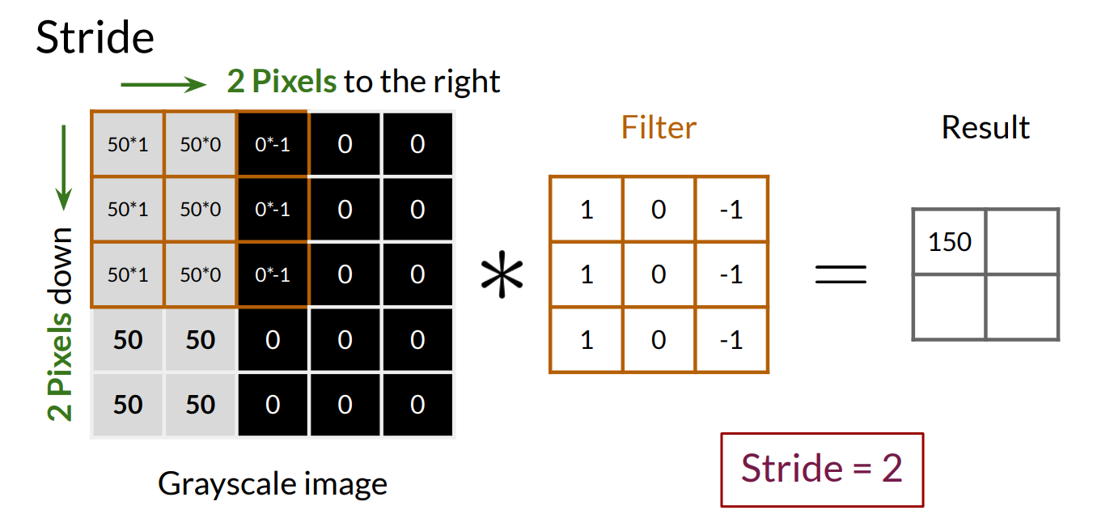

Slide 42
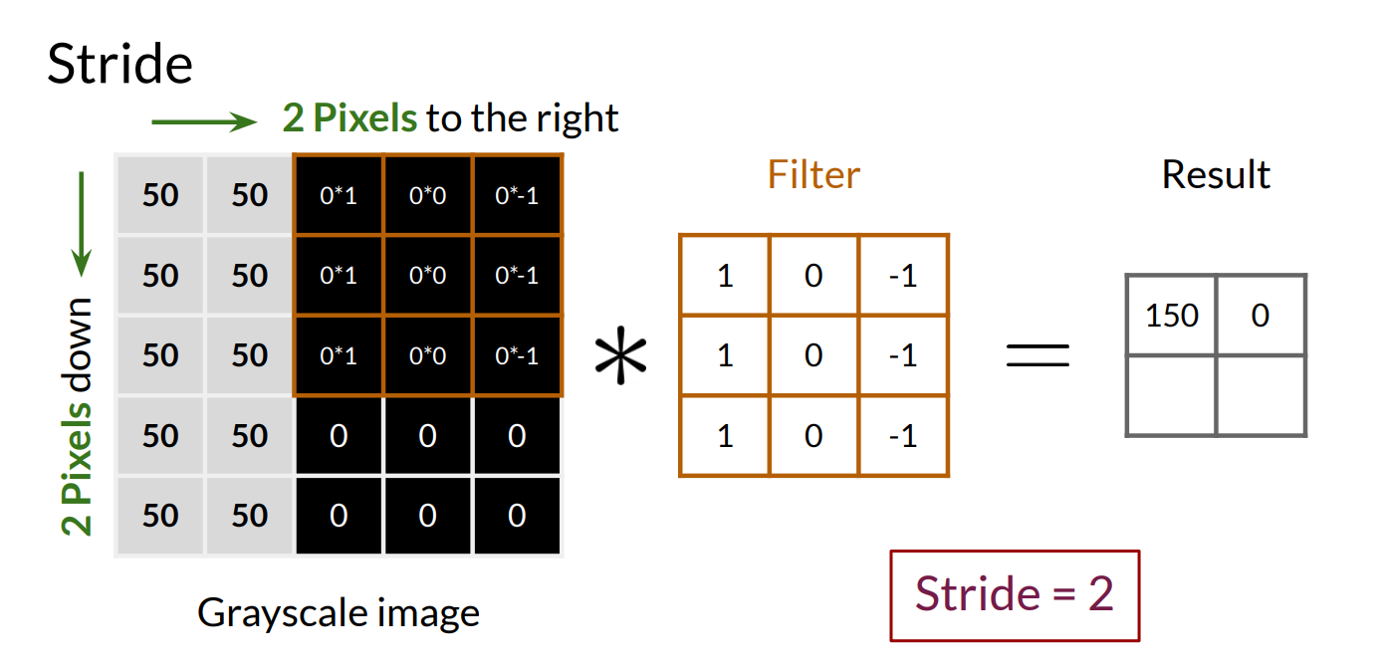

Slide 43
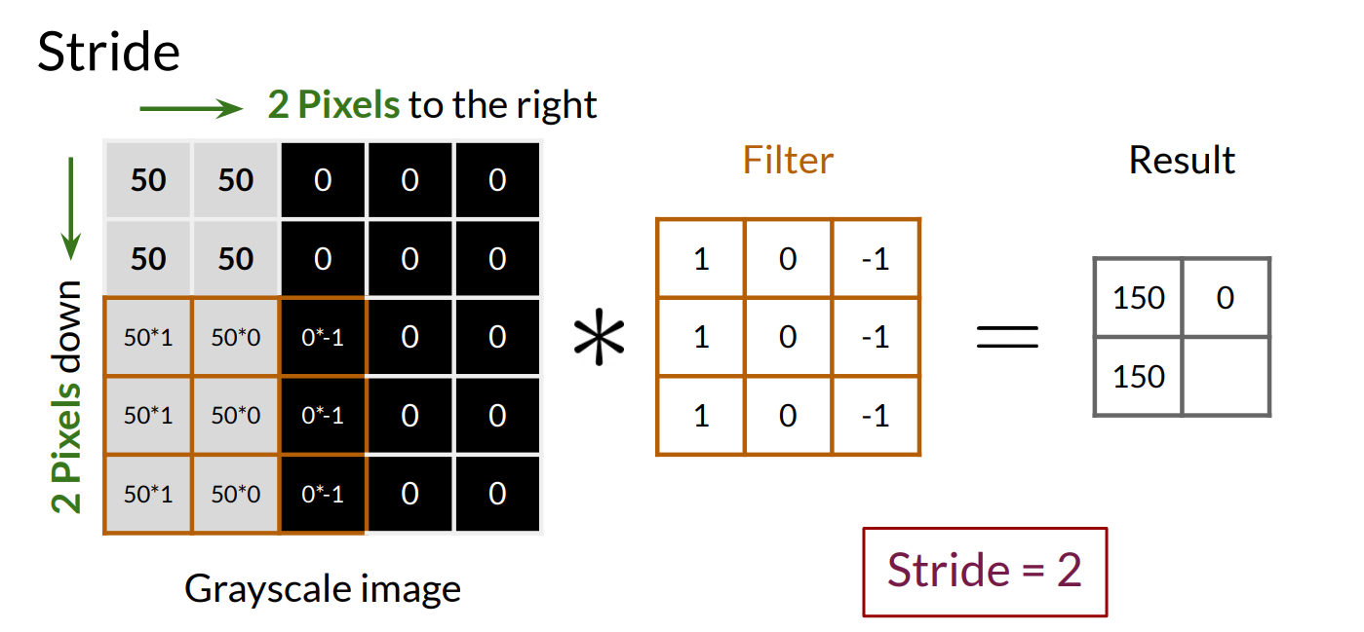

Slide 44
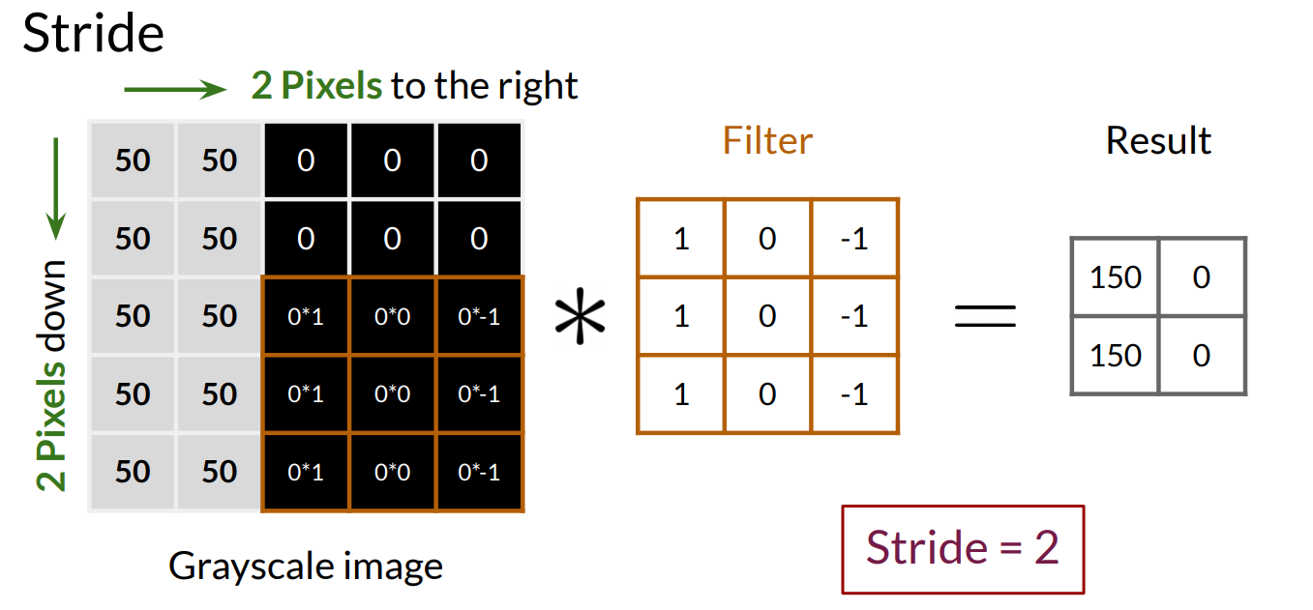

Slide 45


Slide 46


Slide 47


Slide 48


Slide 49


Slide 50
Pooling and up sampling
Pooling is used to reduce the spatial dimension of the input while up sampling is used to increase the size.
Pooling layers help in selecting the most important features from the input, as max pooling selects the most salient features and average pooling provides a balanced representation.

Slide 51

Pooling reduces the dimensions of the image by down sampling it (e.g., a 2×2 pooling operation reduces the size by half).
This means fewer pixels are available to represent details, leading to a loss of fine features.

Slide 52

Retains the strongest (most prominent) features in the feature map

Slide 53

No learned parameters (unlike convolution

Slide 54


Slide 55


Slide 56


Slide 57


Slide 58


Slide 59

Unlike max pooling (which picks the highest value), min pooling focuses on the lowest intensity or least activated pixels.
Helps in certain denoising applications where strong signals are unwanted.
Min Pooling

Slide 60

Average Pooling

Slide 61

Convolution Layer: Computing output feature map dimension

Slide 62
Pooling Layer: Computing output feature map dimension
w_{out} = ((w_{in} - f_{w})/s) + 1 h_{out} = ((h_{in}-f_{h})/s)+1
here, w_{out} indicates width of the output feature map.
h_{out} indicates height of the output feature map
w_{in} indicates width of input feature map
h_{in} indicates height of input feature map
f_{w}, f_{h} indicates width and height of the filter
s indicates stride
Note: If the resultant output feature map dimension is not an integer, floor of that real number will be considered.

Slide 63


Mathematics of 2D convolution in a CNN
How the output size is calculated when applying a convolutional filter (kernel) to an input image without padding and with a stride of 1.
n – f + 1 × n – f + 1
= 6 – 3 + 1 × 6 – 3 + 1
= 4 × 4
3 × 3 ( f × f)
???
6 × 6 ( n × n)
4 × 4

Slide 64






Slide 65
Padding
3 × 3 ( f × f)
4 × 4
Why Padding is required ?
During convolution, the size of the output feature map is determined by the size of the input feature map, the size of the kernel, and the stride.
If we simply apply the kernel on the input feature map, then the output feature map will be smaller than the input.
This can result in the loss of information at the borders of the input feature map. In order to preserve the border information we use padding.
6 × 6 ( n × n)

Slide 66




Padding
p = 1
n+2p–f+1 × n+2p–f+1
= 6 + 2 – 3 + 1 × 6 + 2 – 3 + 1
= 6 × 6
3 × 3 ( f × f)
6 × 6
6 × 6 -> ( 8 × 8)

Slide 67
Valid and Same convolutions
Valid: No padding
Same: Pad so that output size is the same as the input size
n – f + 1 × n – f + 1

Slide 68









Stride

Slide 69

Convolutions on RGB images

Slide 70

Convolutions on RGB images

Slide 71





Convolutions on RGB images

Slide 72








Multiple filters
No stride and no padding

Slide 73
Convolutional Layer
32×32×3 Image
Width
32
Height
32
3
Depth

Slide 74
Convolutional Layer
32×32×3 Image
Width
32
5×5×3 Filter
Height
32
Convolve the filter with the image i.e. “slide over the image spatially, computing dot products”
Convolve the filter with the image i.e. “slide over the image spatially, computing dot products”
3
Depth

Slide 75
Filters always extend the full depth of the input volume
32×32×3 Image
Width
32
5×5×3 Filter
Height
32
Convolve the filter with the image i.e. “slide over the image spatially, computing dot products”
3
Depth

Slide 76
32×32×3 Image
Width
weight mask
32
5×5×3 Filter
Height
32
3
Depth

Slide 77
32×32×3 Image
Width
weight mask
32
5×5×3 Filter
A single value
Height
32
the result of taking a dot product between the filter and a small 5x5x3 chunk of the image (i.e. 5*5*3 = 75-dimensional dot product + bias)
3
Depth

Slide 78
Activation map
32×32×3 Image
Width
weight mask
32
28
5×5×3 Filter
Height
32
convolve (slide) over all spatial locations
28
3
Depth
1

Slide 79
32×32×3 Image
Activation maps
Width
weight mask
32
28
5×5×3 Filter
Height
32
Second filter
28
3
Depth

Slide 80
32×32×3 Image
Activation maps
Width
weight mask
32
28
5×5×3 Filter
Height
32
Third filter
28
3
Depth

Slide 81
32×32×3 Image
Activation maps
Width
weight mask
32
28
5×5×3 Filter
Height
32
Total 96 filters
28
3
Depth
Depth of output volume: 96

Slide 82
32×32×3 Image
Activation maps
32
28
32
28
CONV, e.g.
96 5x5x3 filters
3
96

Slide 83
32×32×3 Image
Activation maps
32
28
One
number
5×5×96
Filter
32
CONV, e.g.
96 5x5x3 filters
28
3
96

Slide 84
32×32×3 Image
Deeper activation
maps
Activation maps
32
28
24
128
5×5×96
Filters
32
28
24
3
96
128

Slide 85
. . .
CONV, e.g.
96 5x5x3 filters
CONV, e.g. 128 5x5x96 filters
CONV
32
28
24
32
28
24
3
96
128

Slide 86


Slide 87
Number of parameters is independent of image size
The input image could be 1000×1000 or 5000×5000, but the number of parameters we have remains 280.
We can use these ten filters to detect features: vertical edges, horizontal edges, maybe other features anywhere even in the very large image with just a very small number of parameters.
This is really one property of convolutional neural nets that makes them less prone to overfitting.
So, once we learn ten feature detectors that work, we could apply this even to very large images and the number of parameters also remains fixed and relatively small as 280 in this example.

Slide 88


Slide 90


Slide 91


Slide 92


Slide 93






ReLU
model.add(Conv2D(32,(3,3),input_shape=(64,64,3),activation='relu'))

Slide 94

Calculating Number of Parameters

Slide 95

Example

Slide 96
Layer | Filter Size | Input Channels | Output Filters | Total Parameters
Conv1 | 3×3 | 3 | 64 | (3×3×3 + 1) × 64 = 1,792
Conv2 | 5×5 | 64 | 128 | (5×5×64 + 1) × 128 = 204,928

Slide 97

Calculating the output when an image passes through a Convolutional layer

Slide 98
Example
Image: 32 × 32 × 3
Filter size: 5 × 5
Number of filters: 6
Stride = 1
Padding = 0
Image: 32 × 32 × 3
Filter size: 5 × 5
Number of filters: 6
Stride = 1
Padding = 2
Without padding
With padding

Slide 99


Example
Image: 32 × 32 × 3
Filter size: 5 × 5
Number of filters: 6
Stride = 1
Padding = 0
Image: 32 × 32 × 3
Filter size: 5 × 5
Number of filters: 6
Stride = 1
Padding = 2
Without padding
With padding

Slide 100



Pooling
Average Pooling
Stride and the window size
By selecting the maximum value, it emphasizes the
most salient feature within a region reduces the impact of less important features.
4 × 4
Max Pooling
2 × 2

Slide 101


model.add(MaxPooling2D((2,2)))

Slide 102


Calculating the output when an image passes through a Pooling (Max) layer
Layer Type | Input Size | Filter (F) | Stride (S) | Output Size
Max Pooling | 8 × 8 × 1 | 2 × 2 | 2 | 4 × 4 × 1

Slide 103


Slide 104


model.add(Flatten())

Slide 105

model.add(Flatten())
model.add(Dense(128, activation='relu'))
model.add(Dense(units=3,activation='softmax'))
model.compile(optimizer='adam',loss=‘categorical_crossentropy',
metrics=['accuracy'])
model.fit(training_set, epochs = 10)

Slide 106


Slide 107


Slide 108


Slide 109


Slide 110


Slide 111
Thank you

